Slide 1
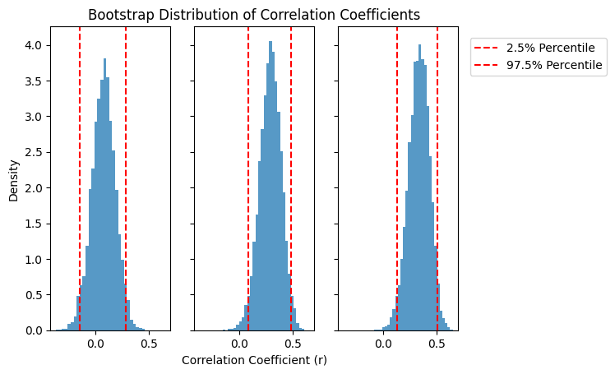
a)
b)
c)
a)
inflation
b)
win
c)
loss

Slide 2
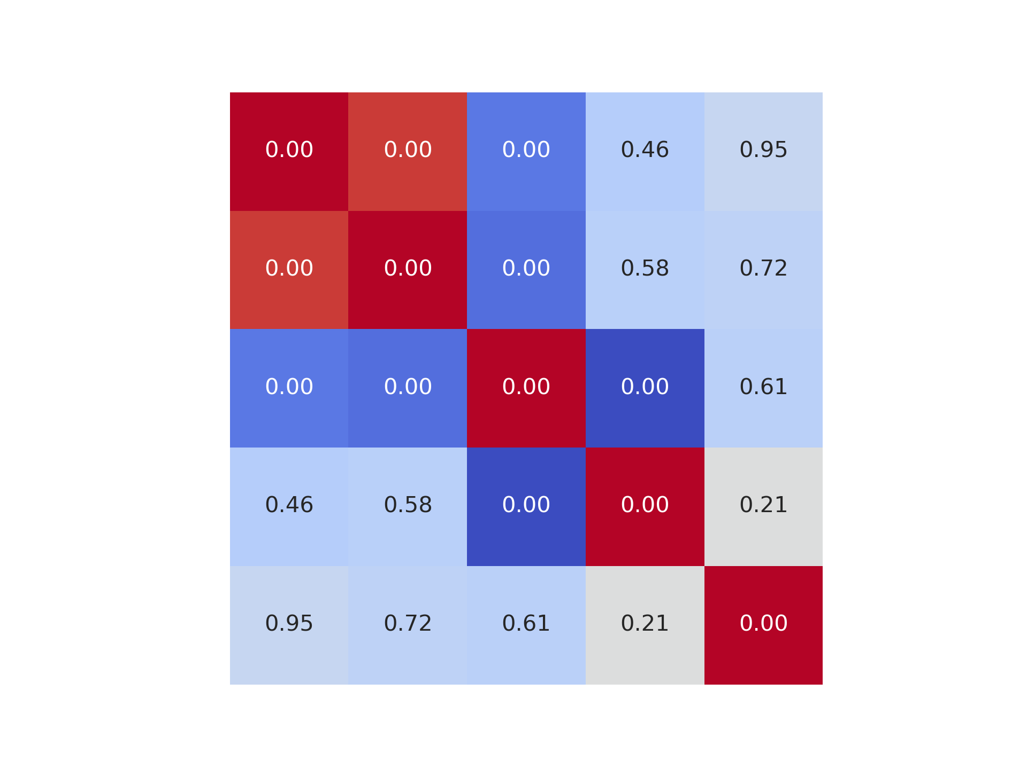
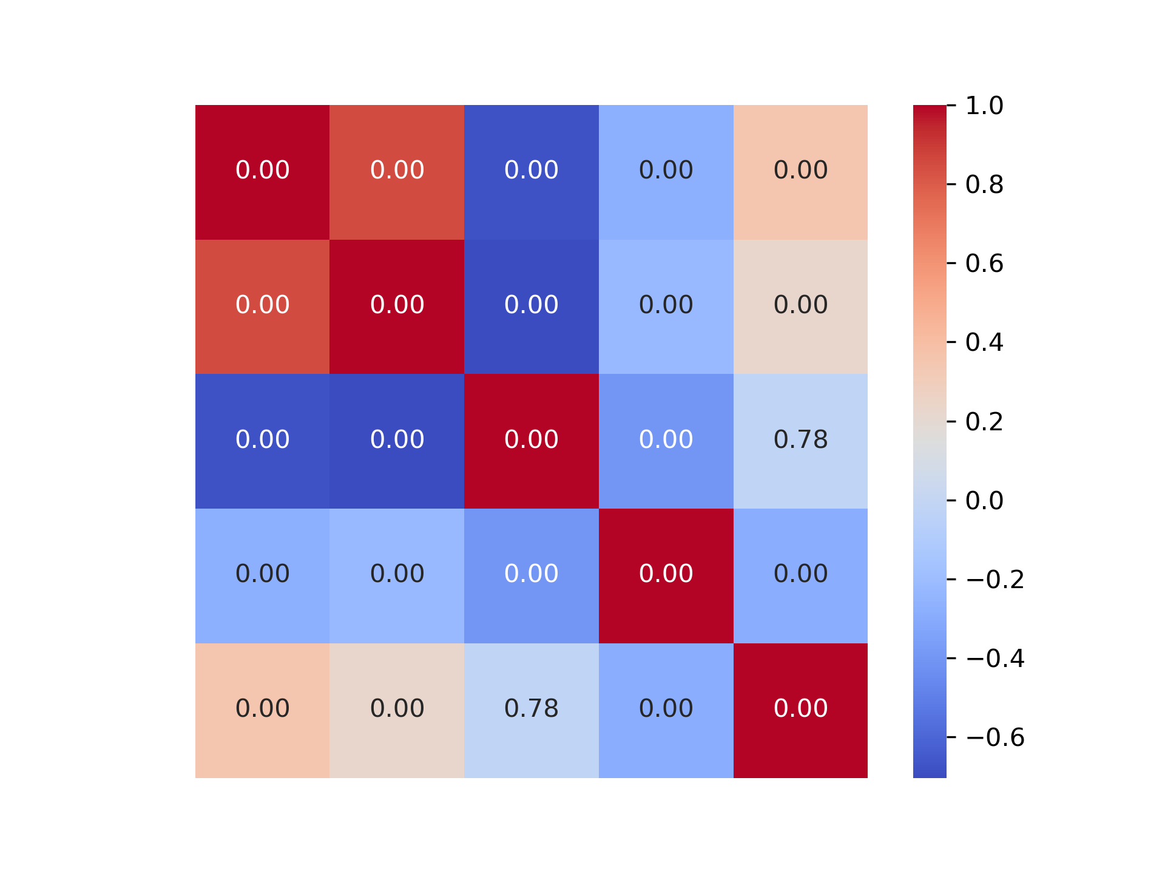
Adults
Children
Adjusted pumps
Proportion of explosions
Total earnings
RT at pumps
Ages

Slide 3
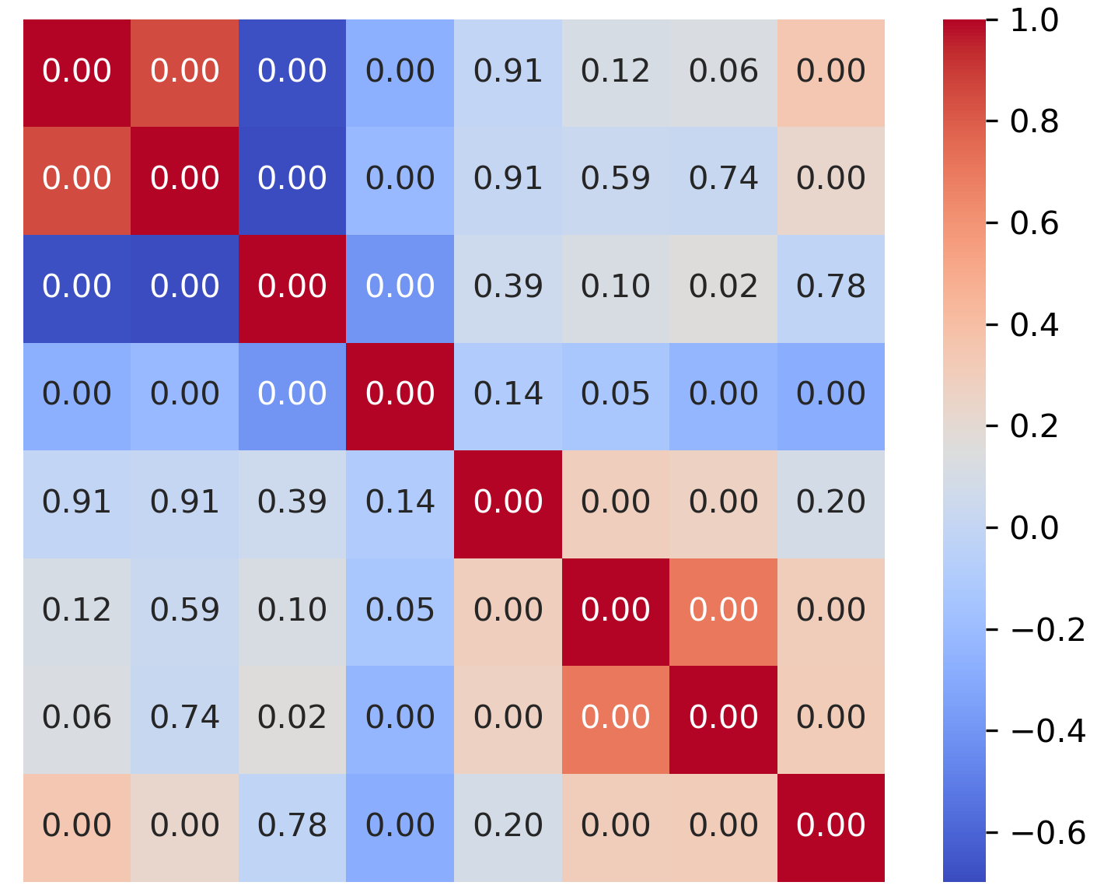
Adjusted pumps
Proportion of explosions
Total earnings
RT at pumps
MI_inflation
MI_win
MI_loss
Ages

Slide 5
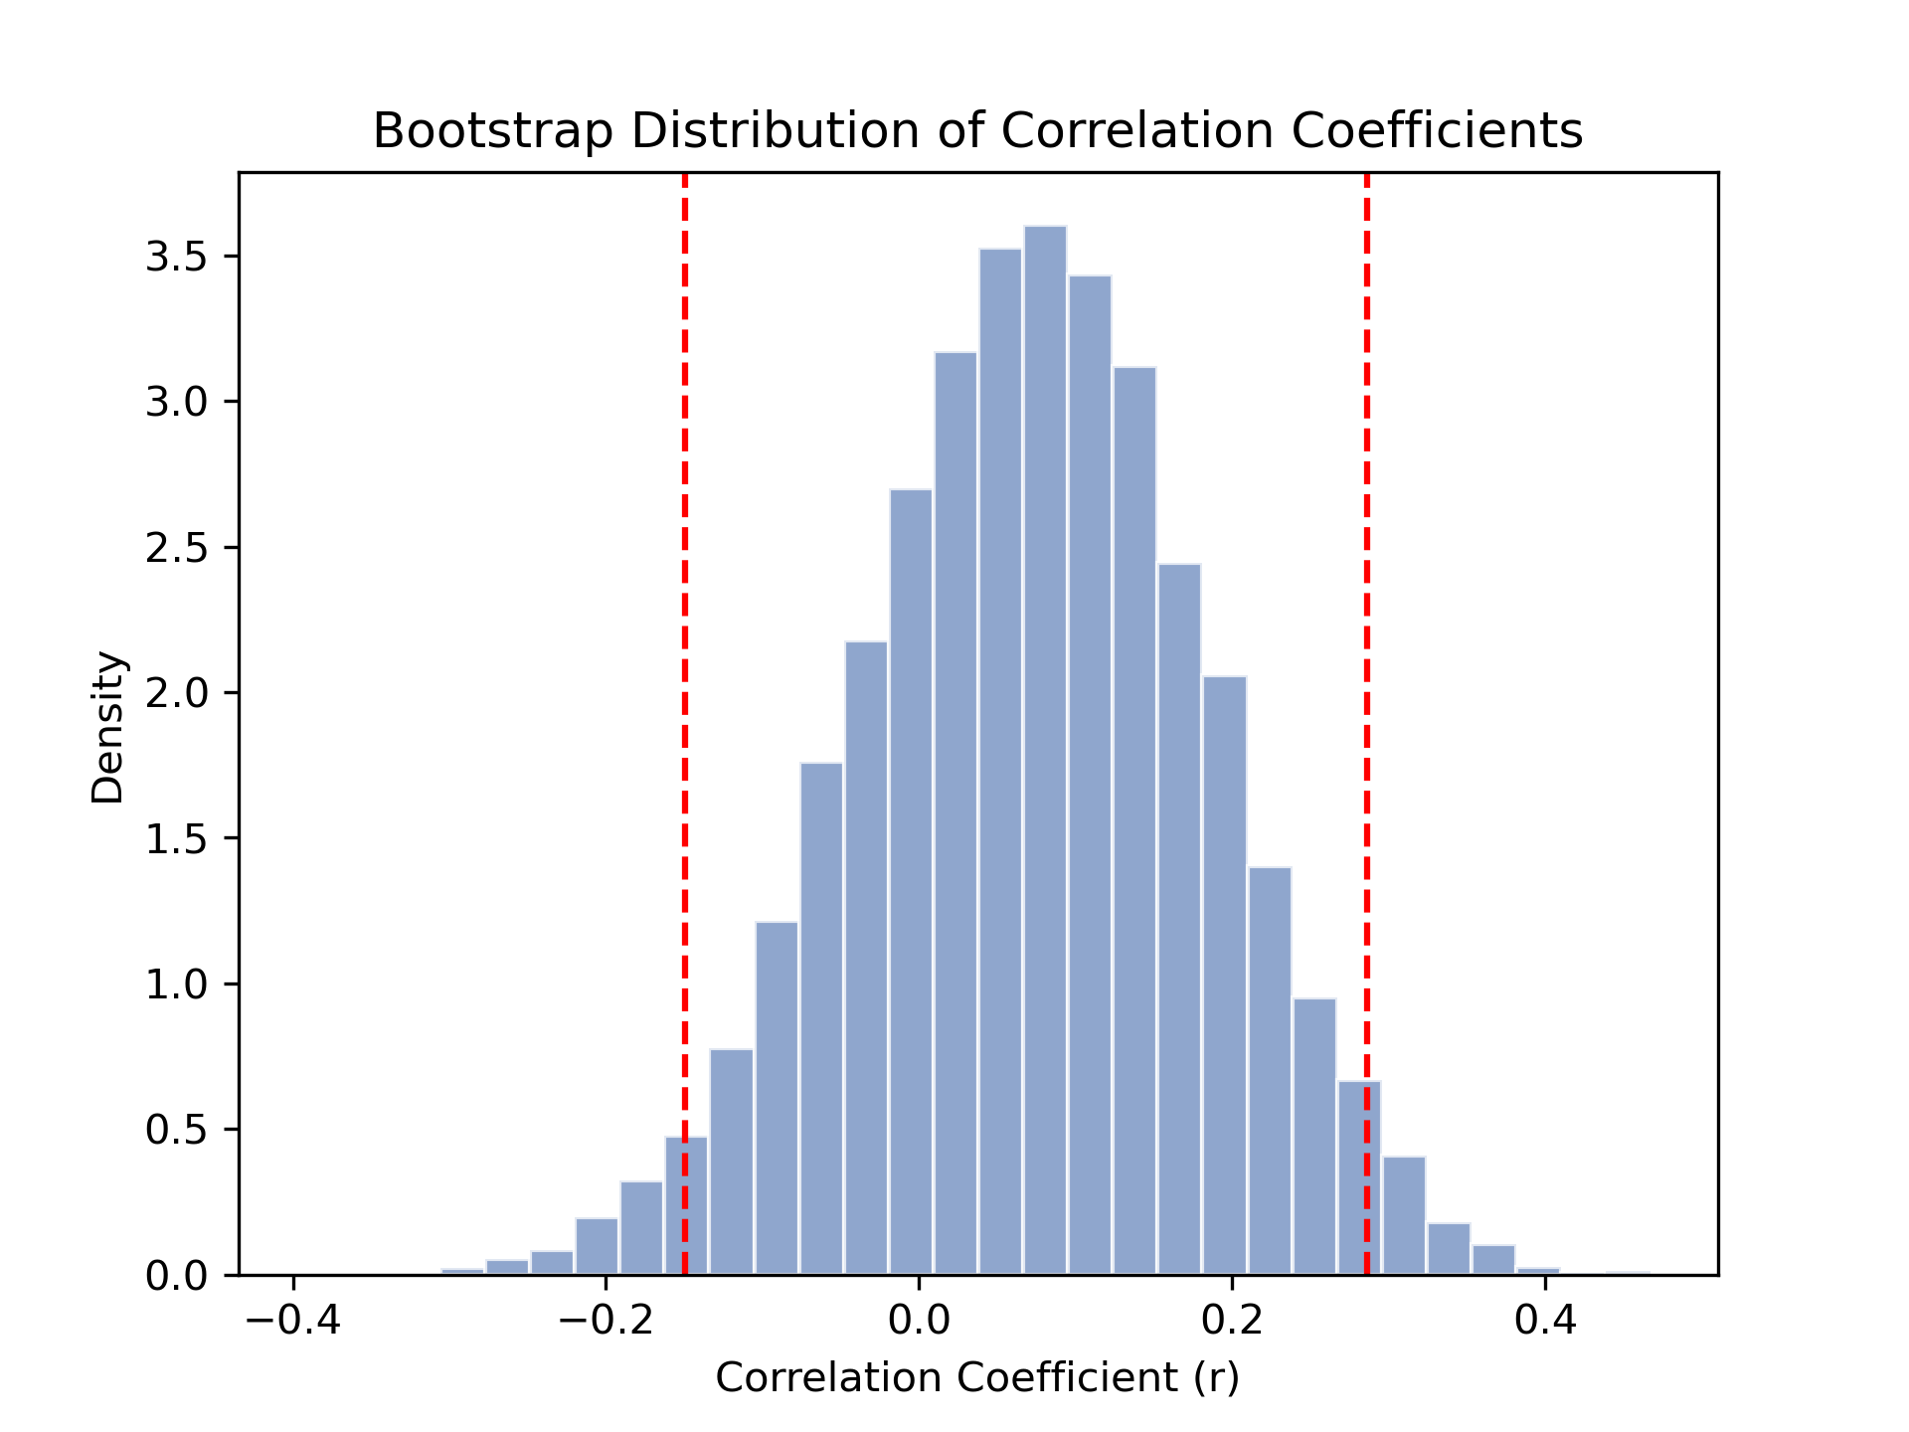
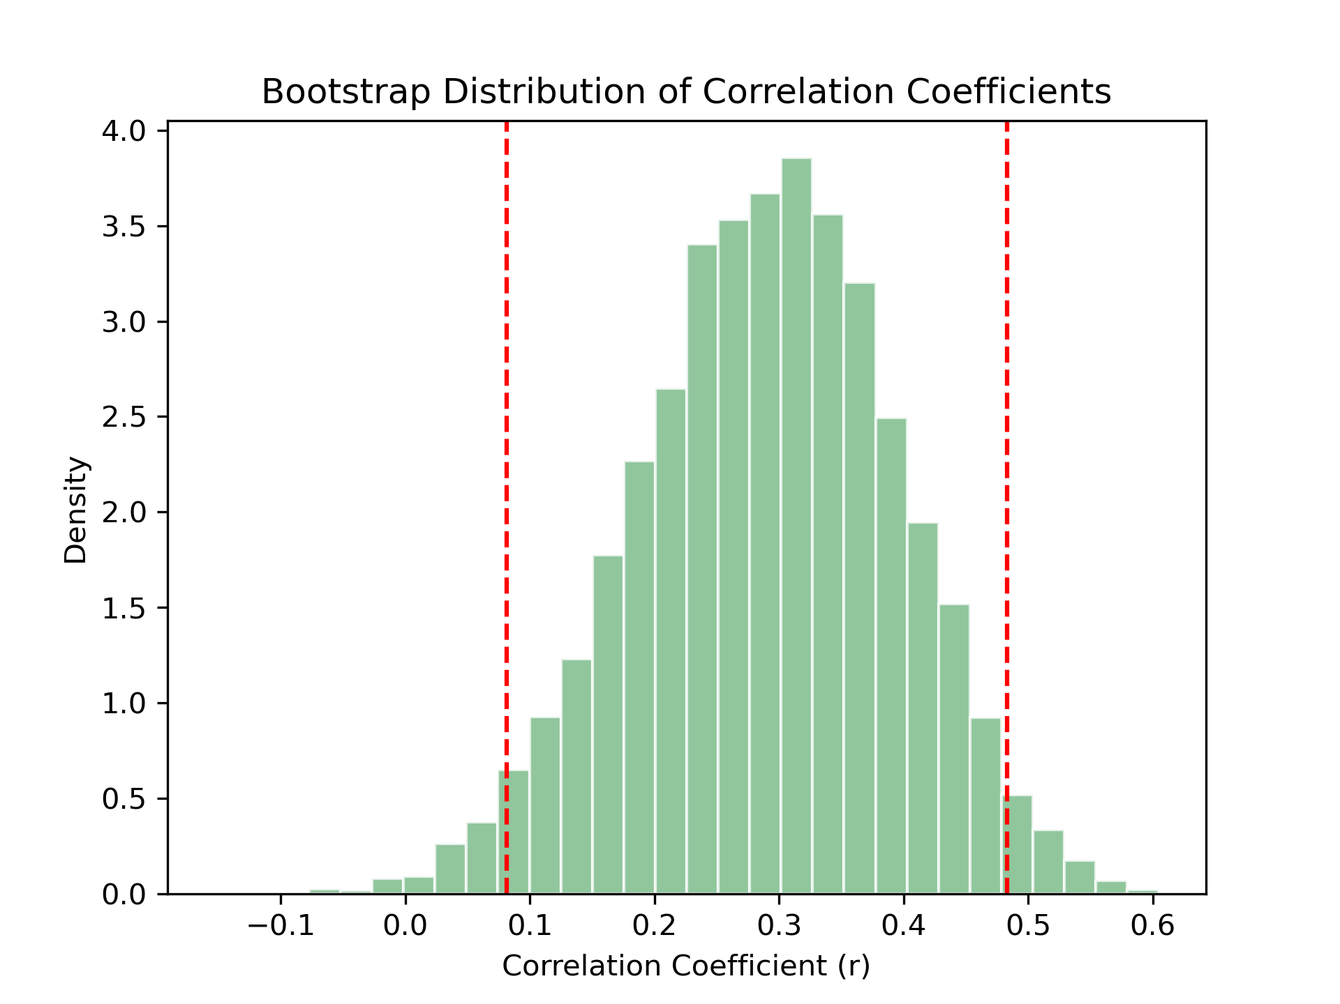
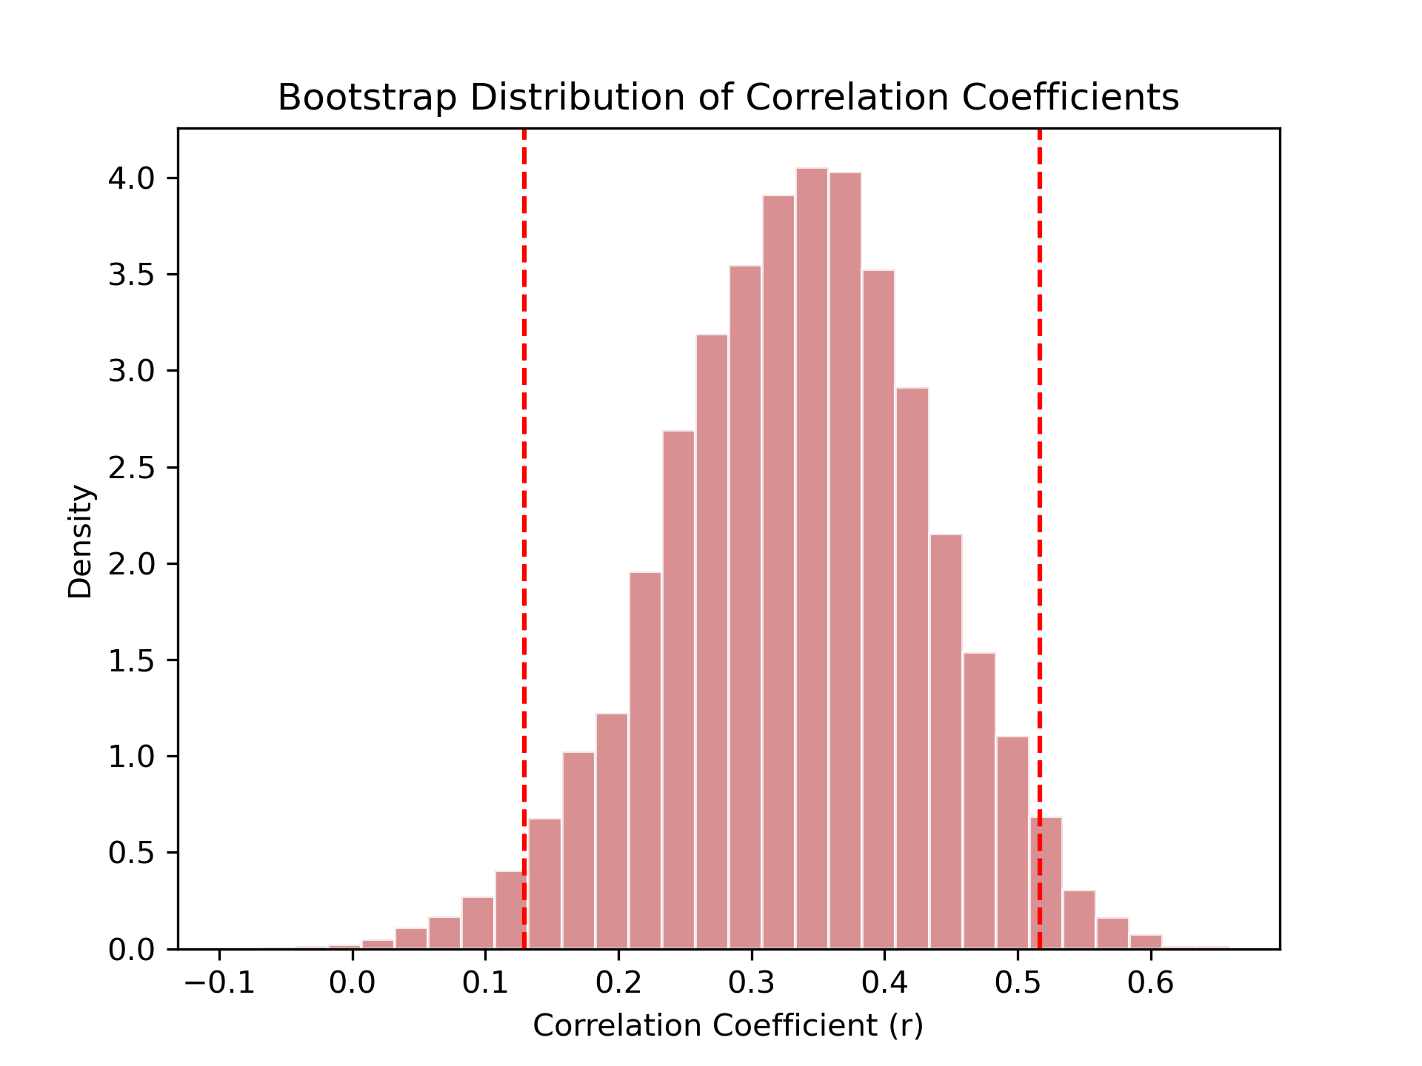
Inflation
Win Outcome
Loss Outcome
Maturation index
Maturation index
Maturation index
Age
Age
Age
Density
Density
Density
Bootstrapped correlations (r)
Bootstrapped correlations (r)
Bootstrapped correlations (r)

Slide 6
A
Inflation
B
Win Outcome
C
Loss Outcome
Density
Density
Density
Bootstrapped correlations (r)
Bootstrapped correlations (r)
Bootstrapped correlations (r)

Slide 7
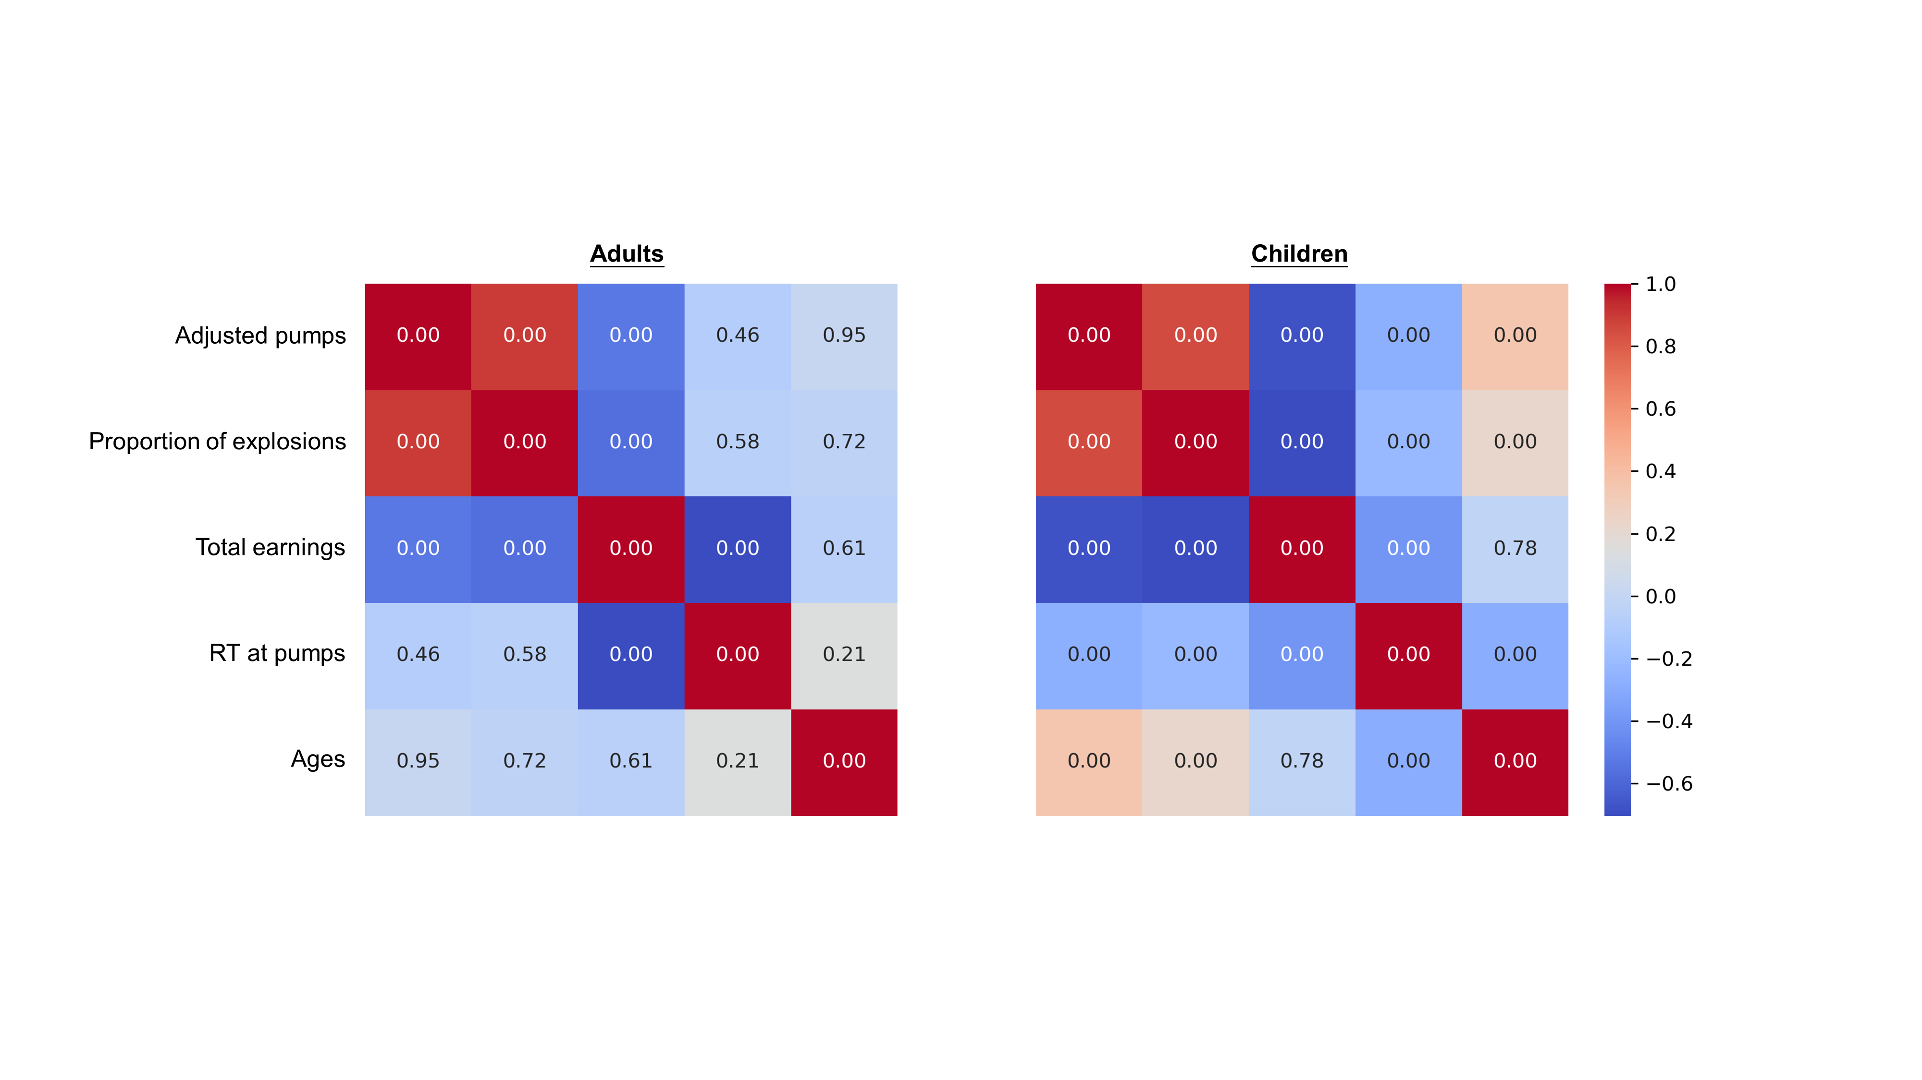
D

Slide 8
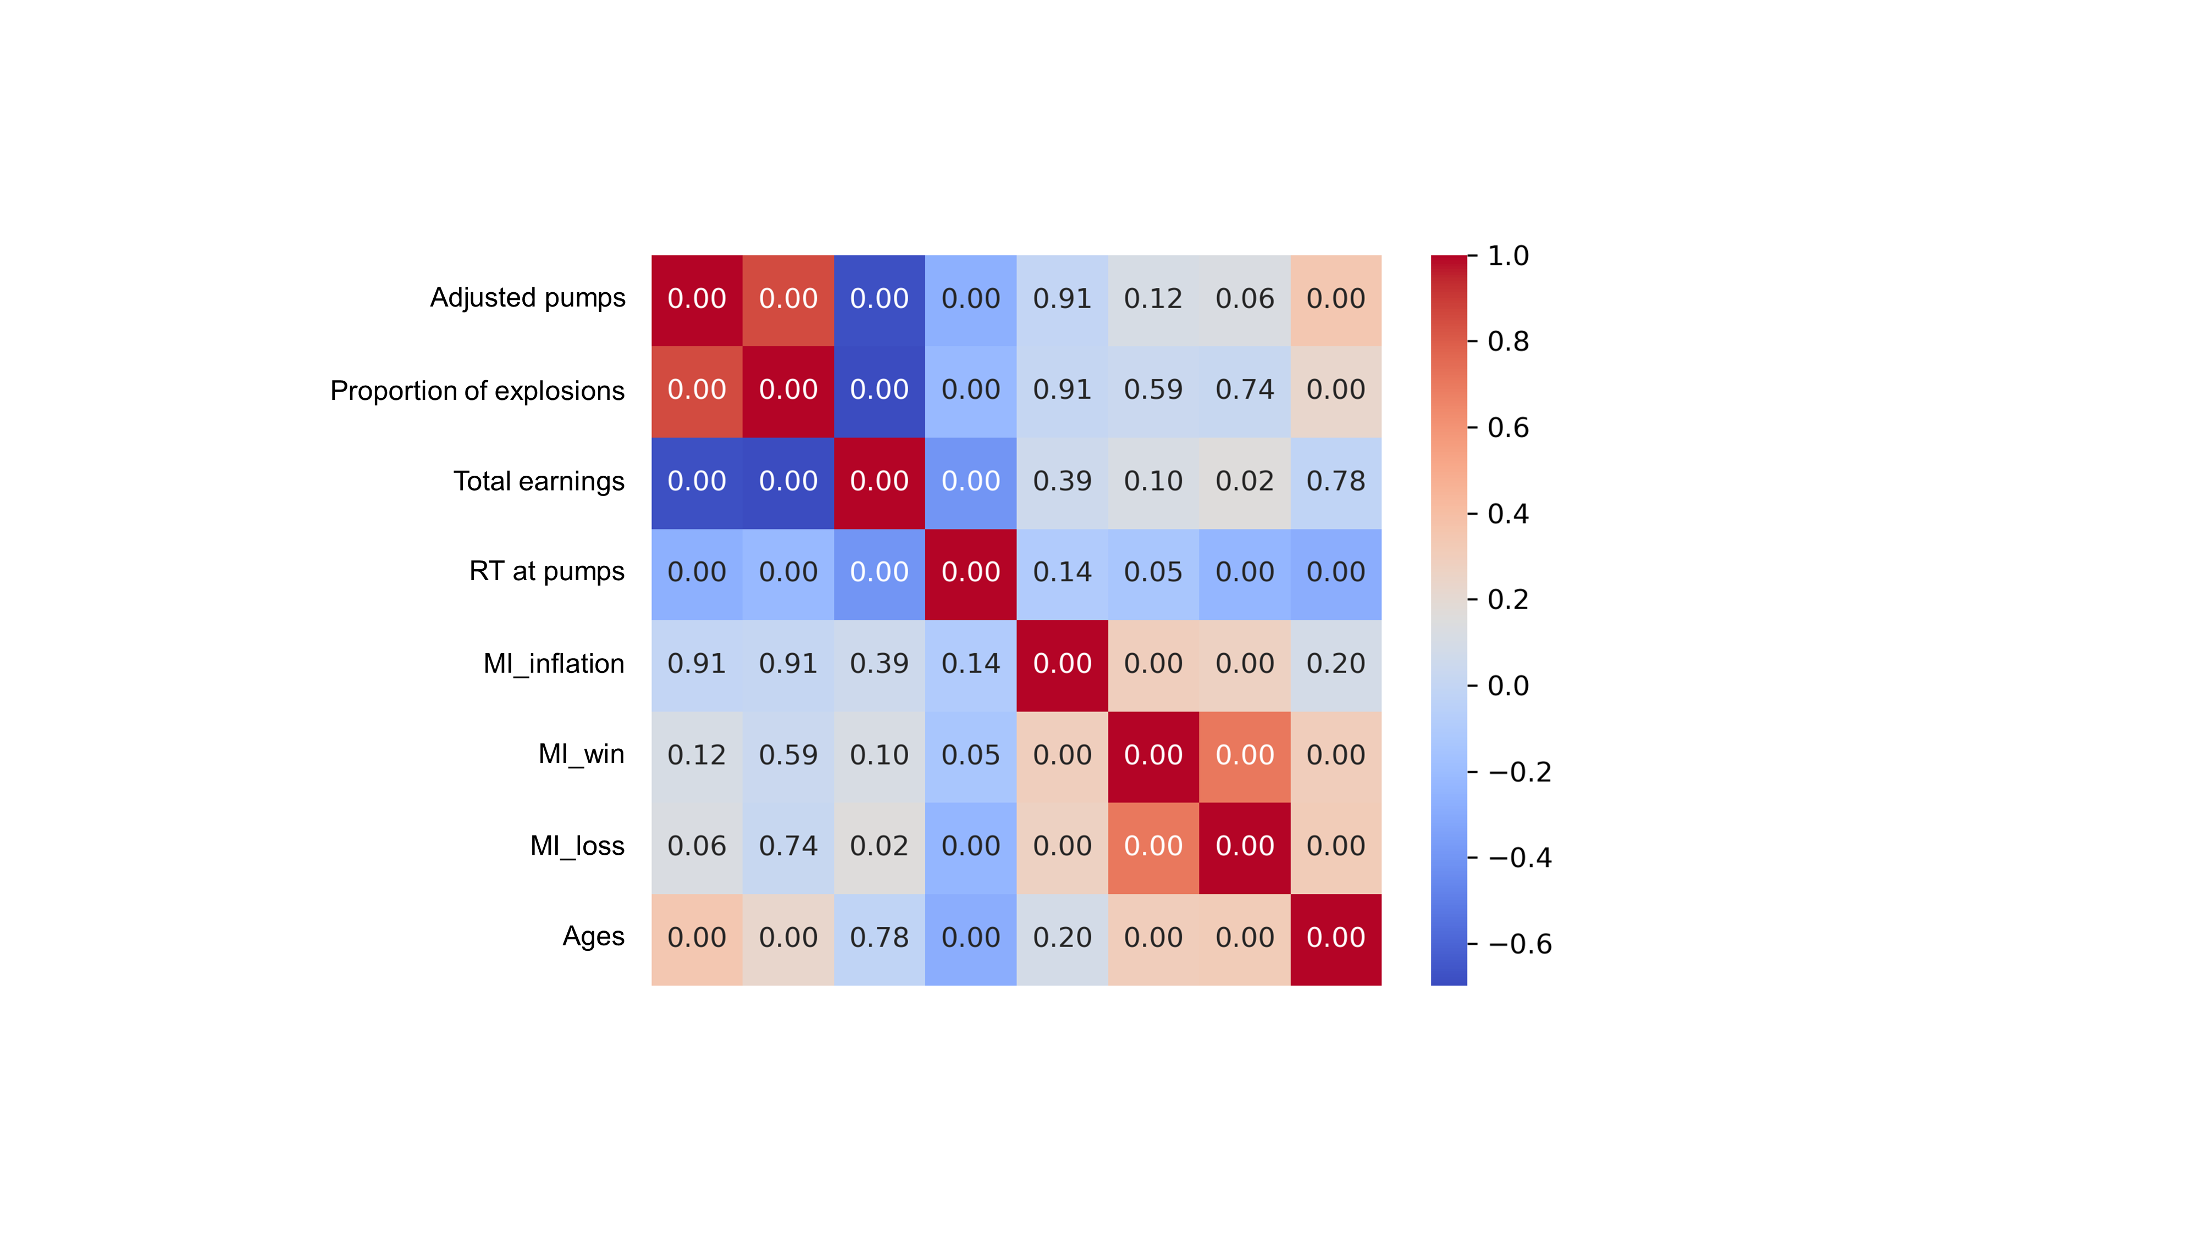
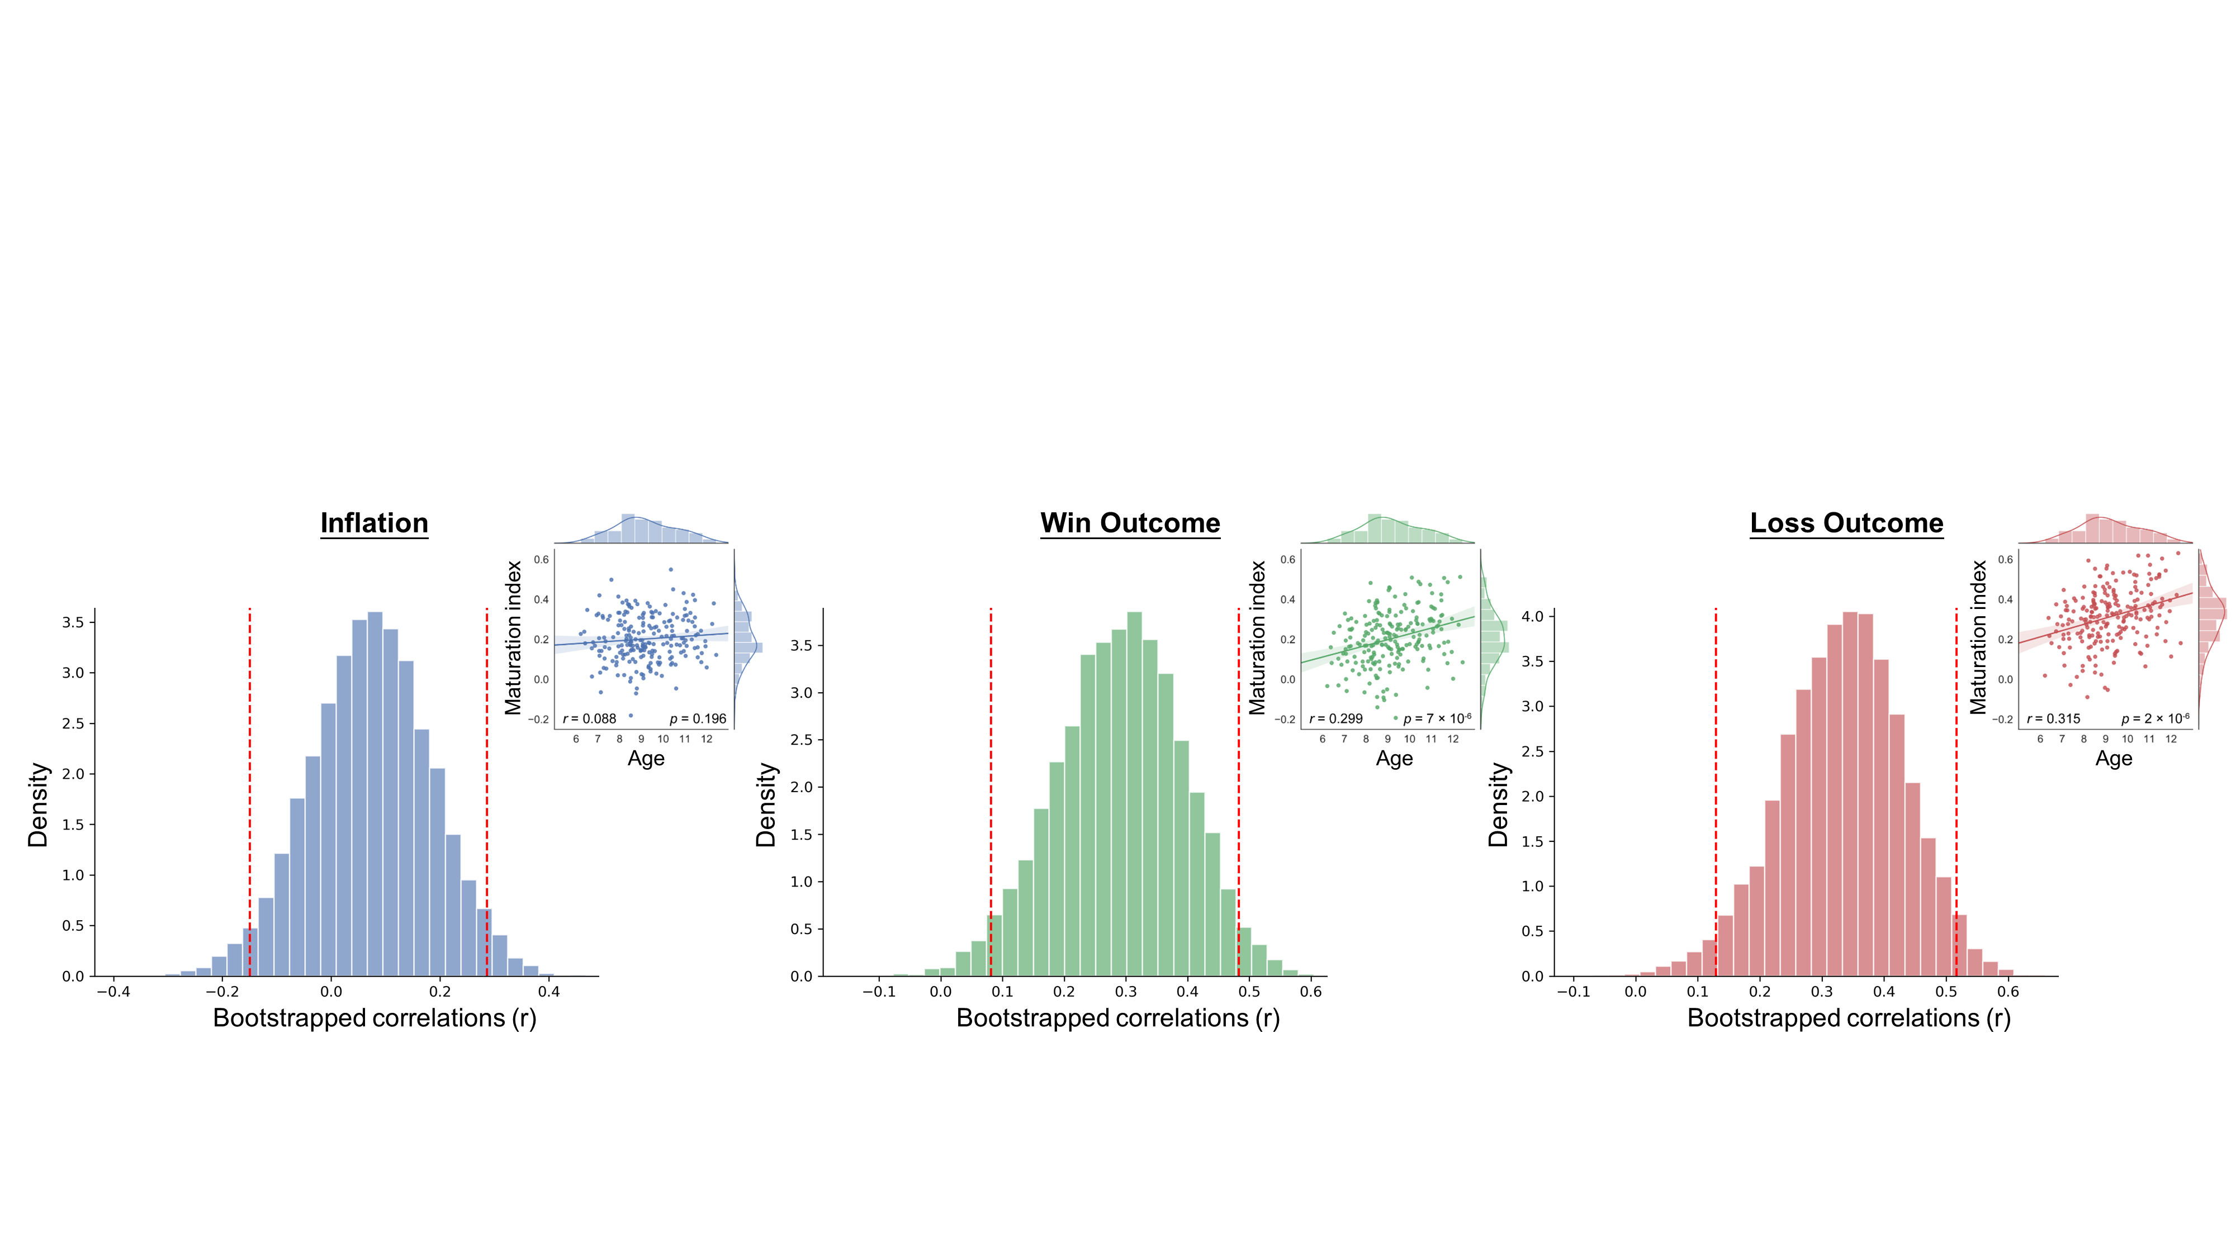
A
B
C
D
E

Slide 9
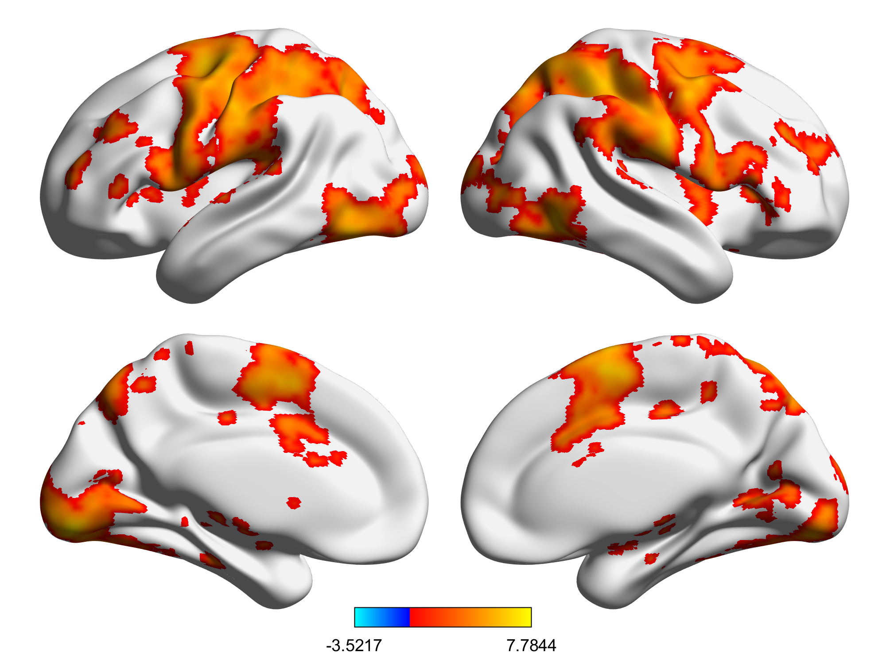
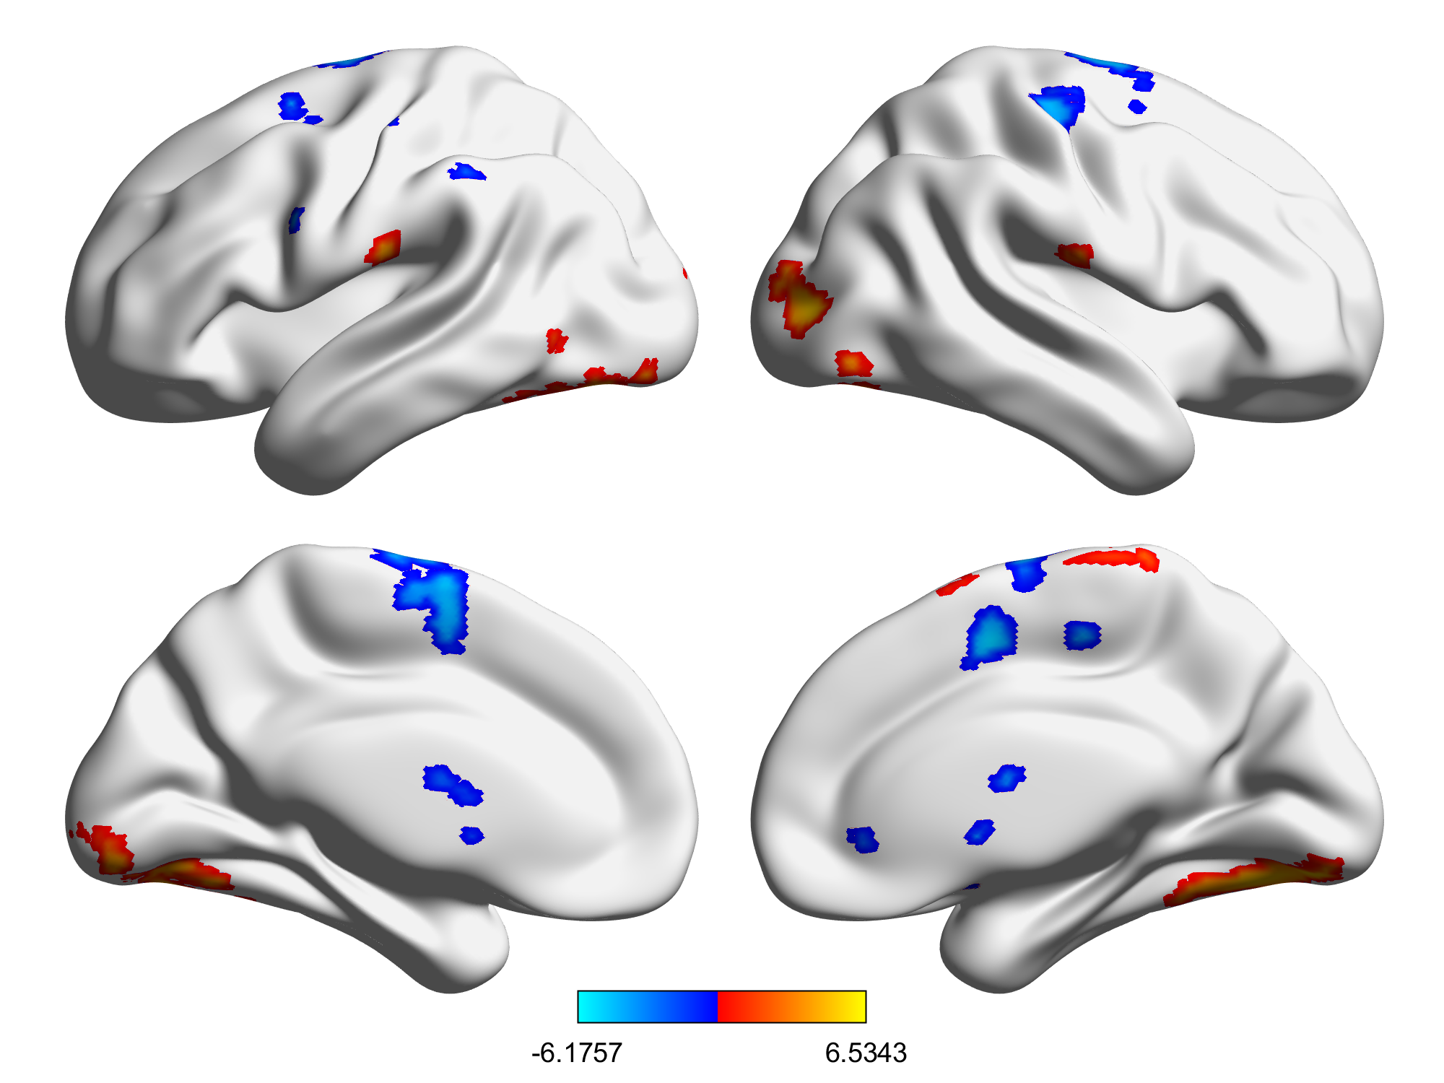
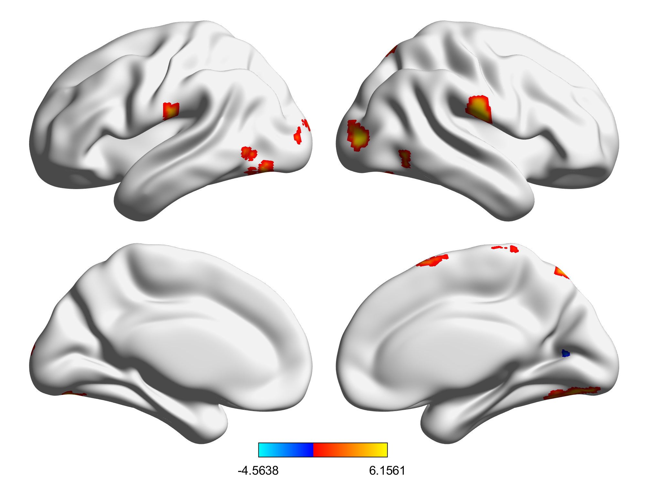
Inflation
Win Outcome
Loss Outcome
Adults > Children
Adults < Children

Slide 10
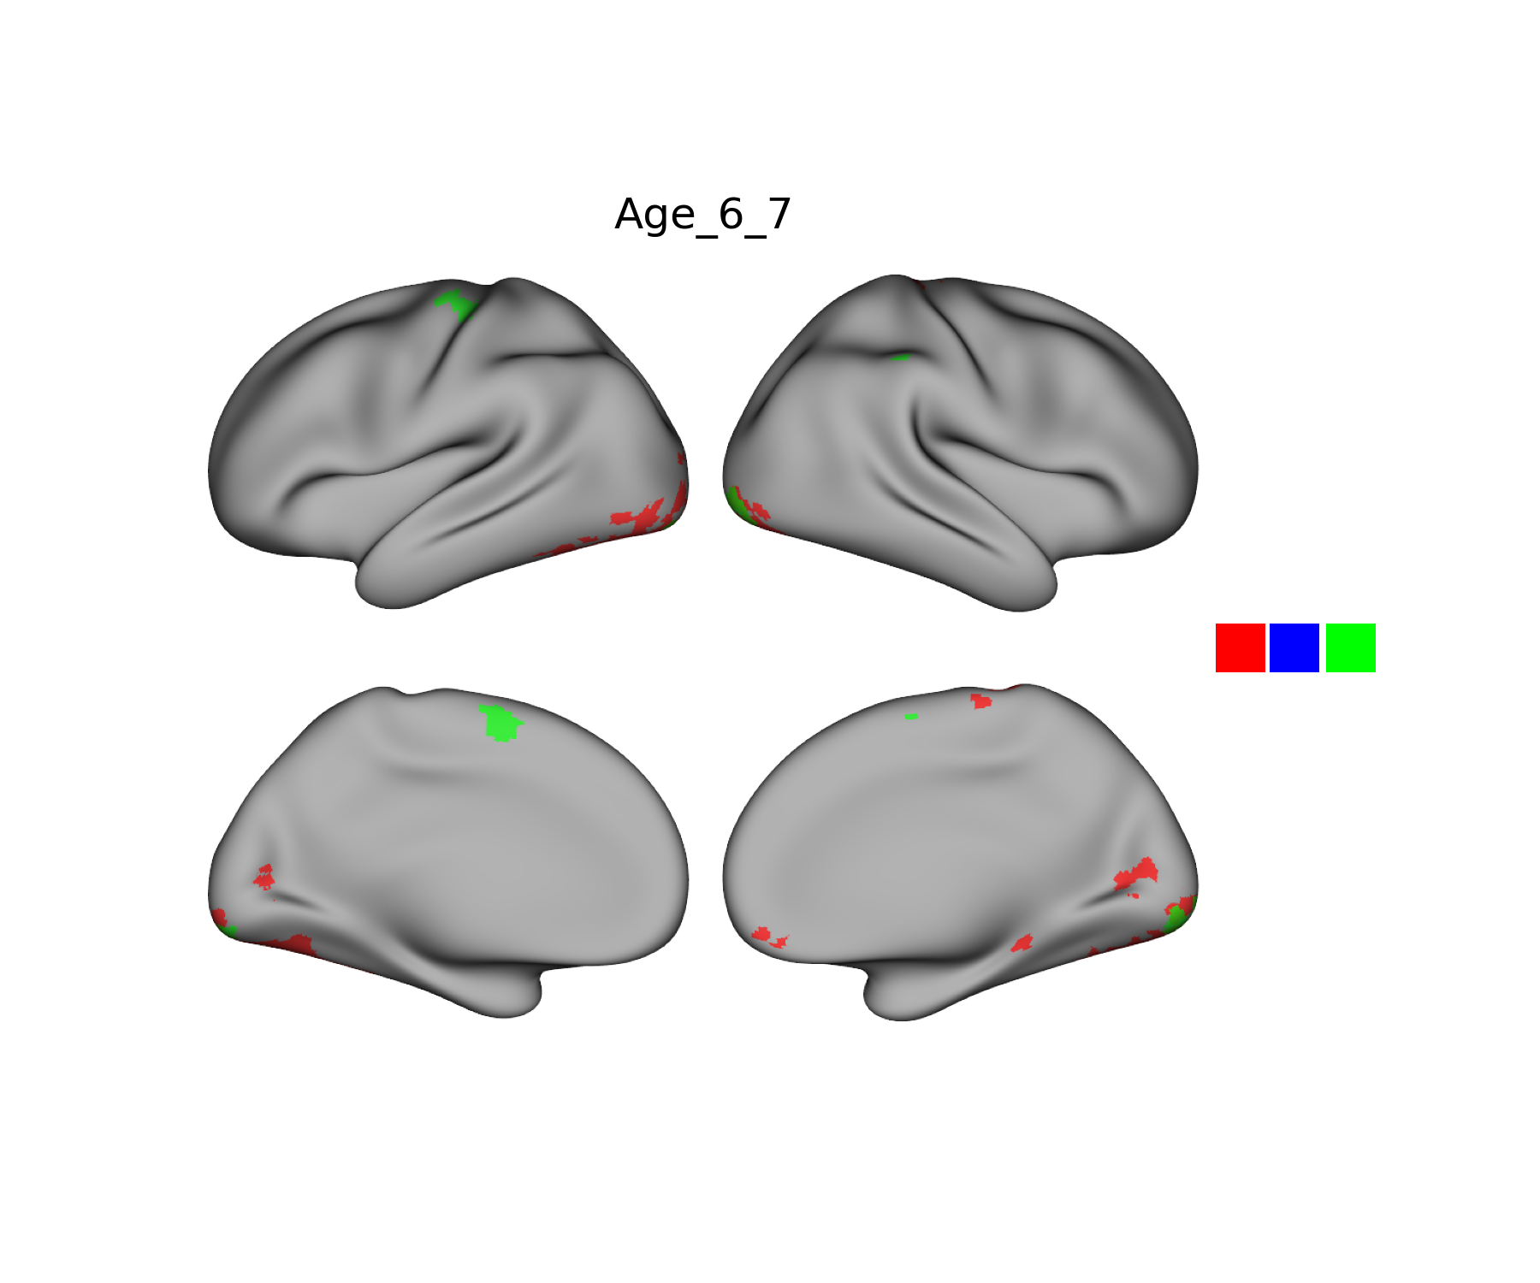
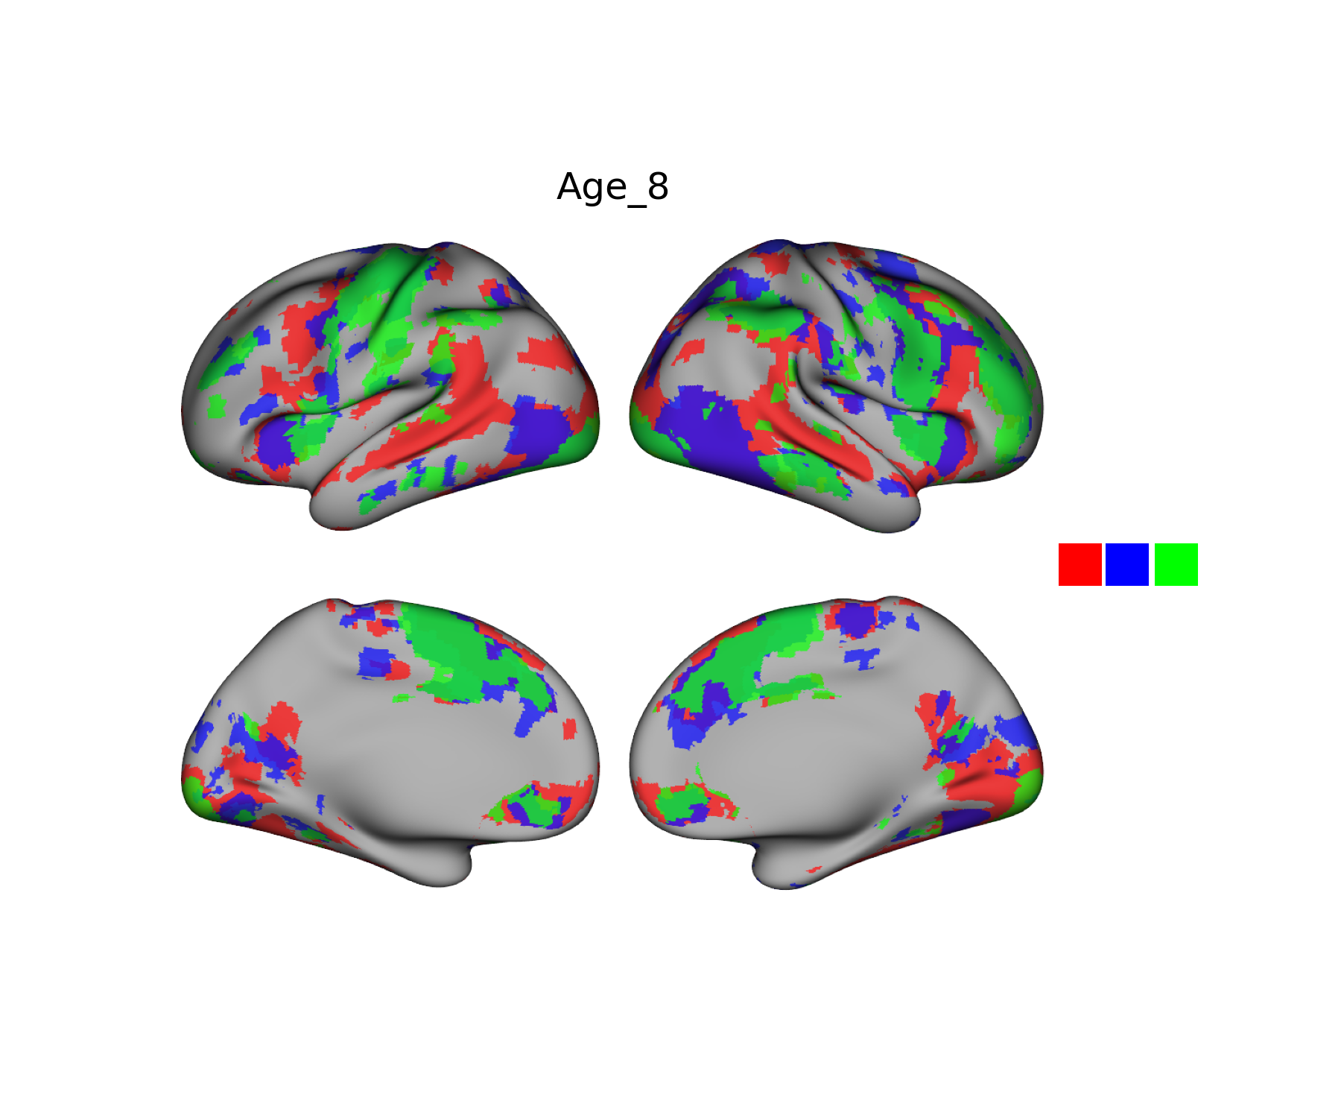
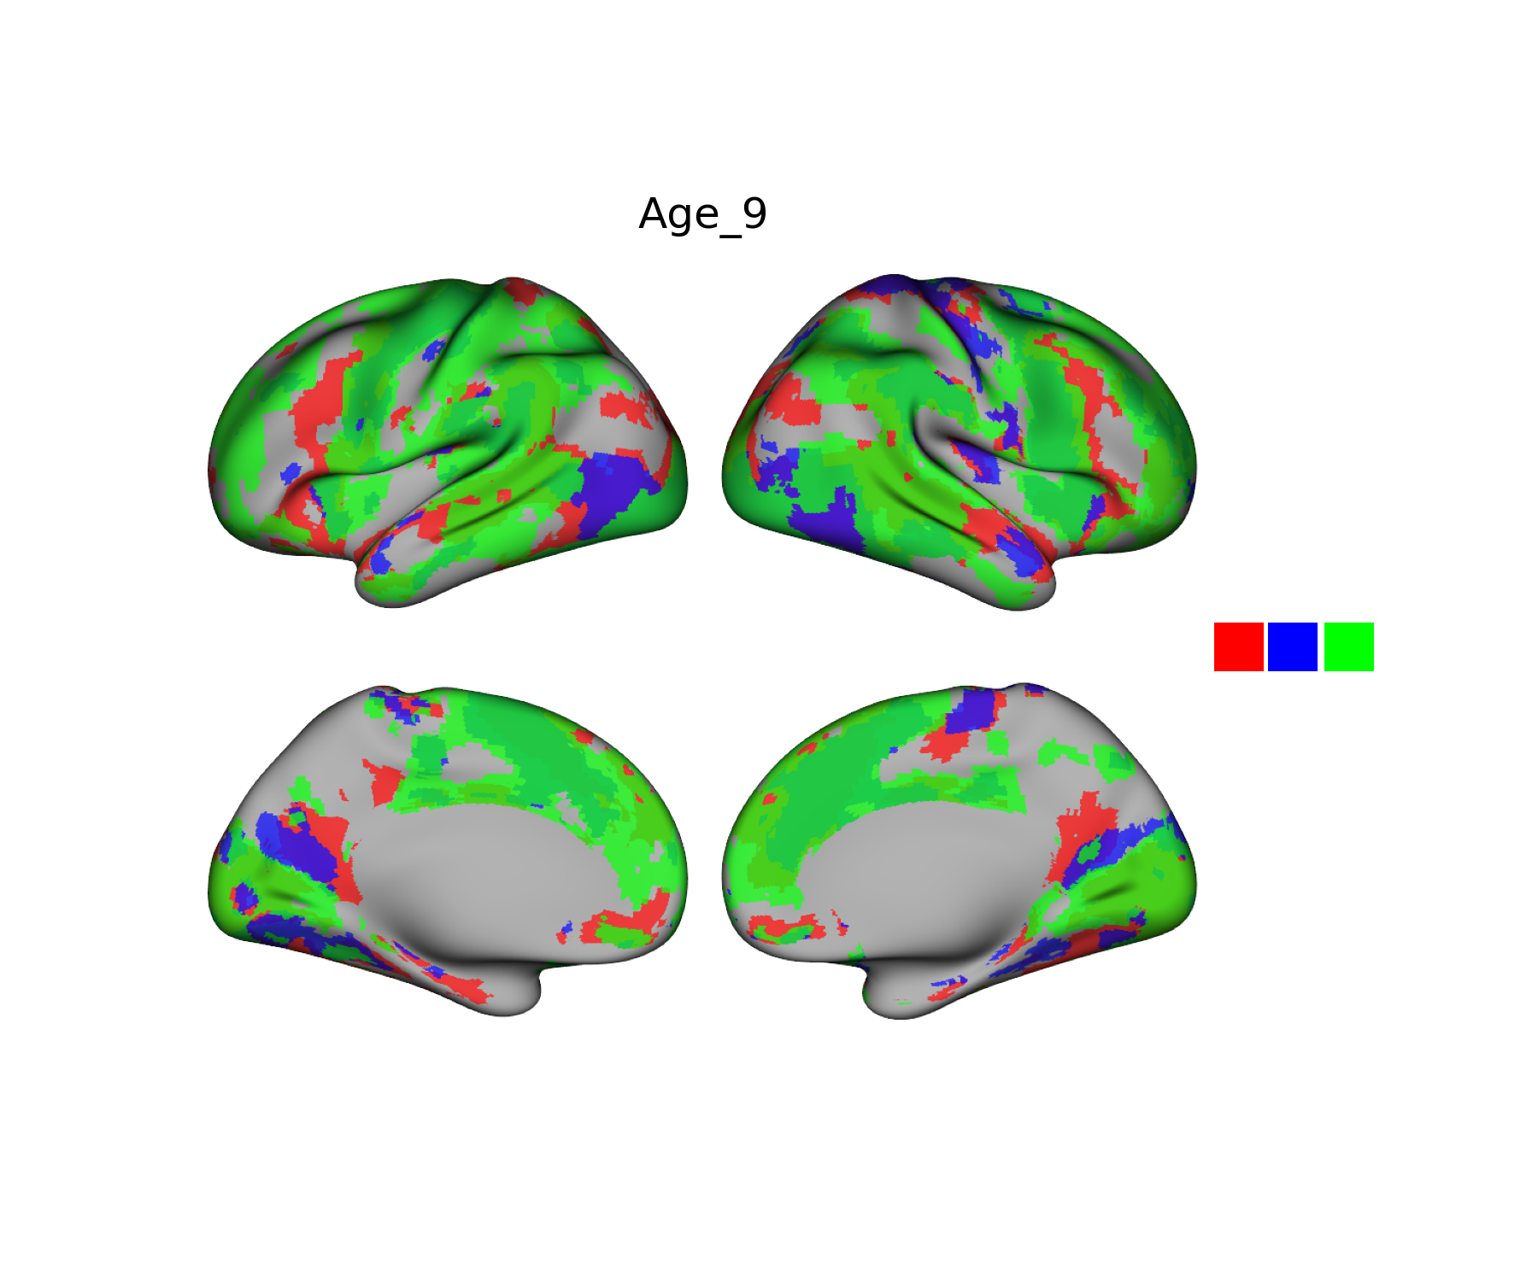



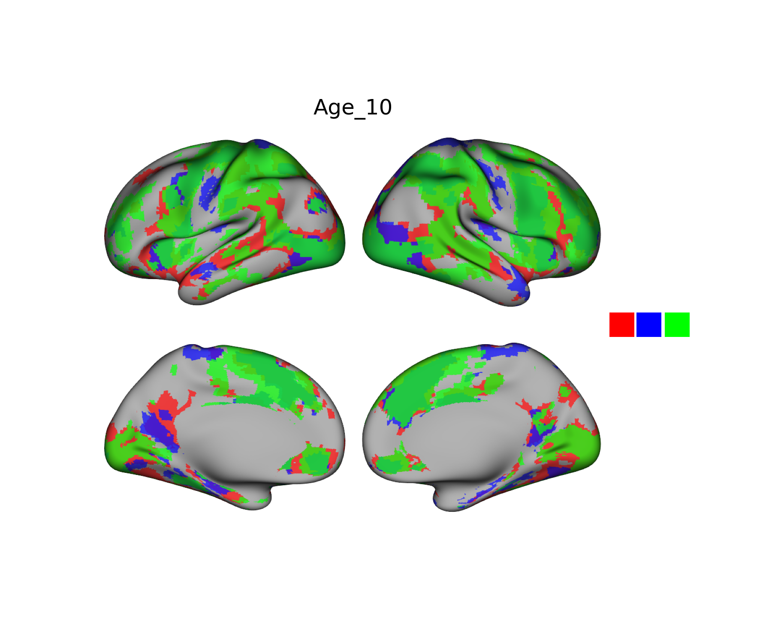
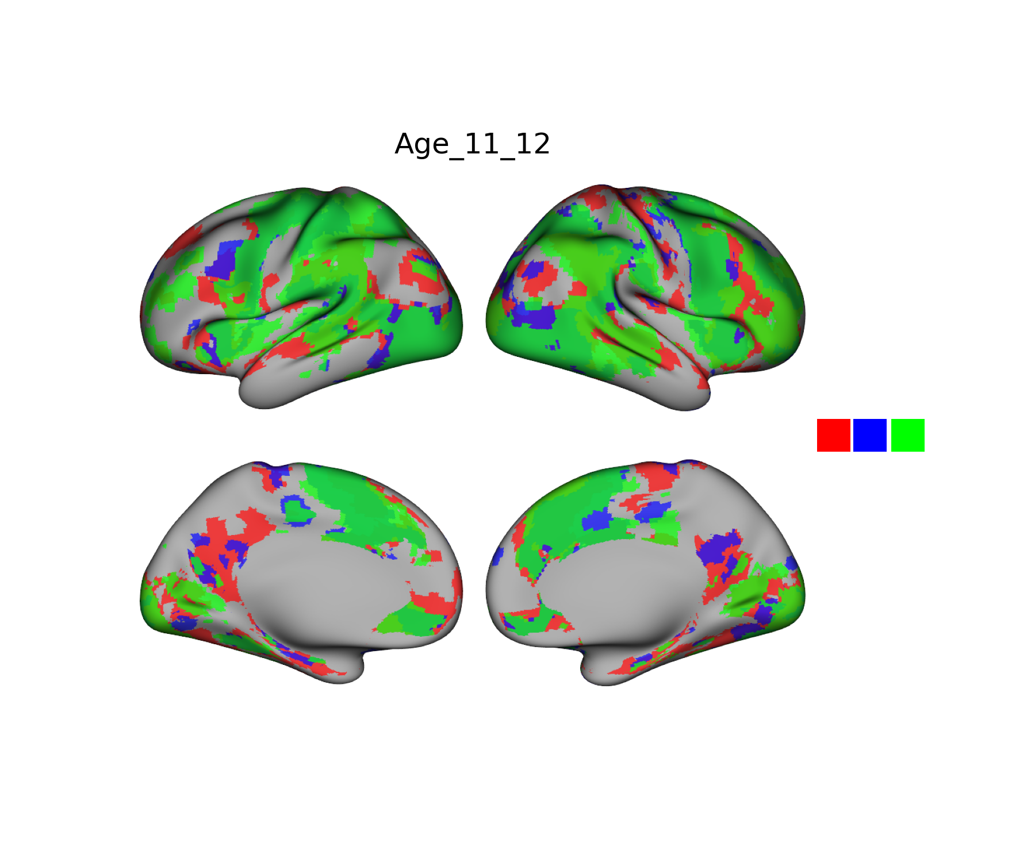
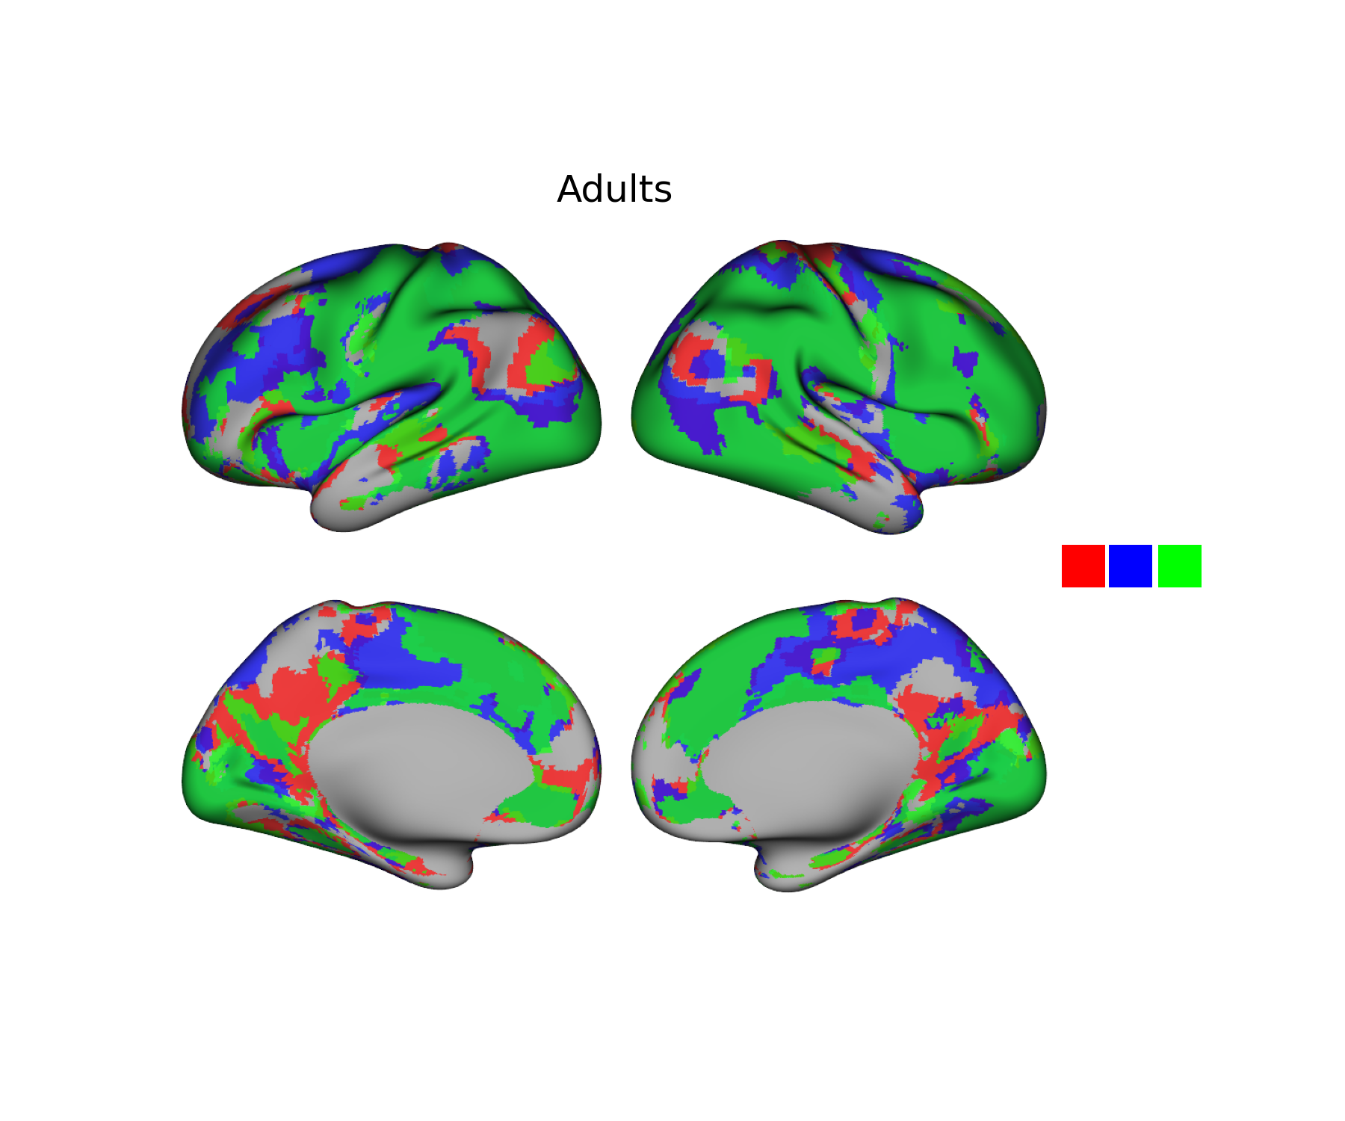



Age 6&7
Age 8
Age 9
Age 10
Age 11&12
Adults

Slide 11
Age 6&7
Age 8
Age 9
Age 10
Age 11&12

